Slide 1

Software Engineering Doctor Appointment Booking System
By
Alugala Vinay Kumar(2110030350)
Reddamalla Nagamaneeshwar Reddy (2110030344)
Therala Sandeep(2110030196)
Gattu Sai Charan (2110030437)
Under the guidance of
(Professor Dr . Sheikh Fahad Ahmad)

Slide 2
Problem statement and domain
Admin will have authority to register hospital application and assign them proper categories like (Heart specialist, Child specialist, General physician etc) by checking their relevant documents.
Users will access the hospital using internet in which user can find the doctors of a selected category book an appointment.
The doctor will be able to add a medical record of the patient (Prescriptions) can add vaccinations as required by the user.
Registered hospital can access the patient prescription provided by the doctor by patient ID.
Our main objective is to develop a user friendly application with user-friendly interface to help user interact easily with the system, the proposed application will be tested and validated according to the standards rules and regulations in order to make it a bug free application.

Slide 3
Existing solutions/ Naïve solutions
As the demand for healthcare facilities has increased over the years, there have been certain hurdles that have been encountered. Inability to access healthcare facilities from faraway places, not being able to get doctor’s appointments on time, irregular medical treatment – these are some of the issues that have given rise to a thorough healthcare solutions umbrella – the Doctor Appointment Website.
This pandemic that has almost increased all to for online healthcare services rather than physically visiting doctors and hospitals. Looking at the need of the hour, there have been the best online doctor consultation Website that have made things much easier.

Slide 4
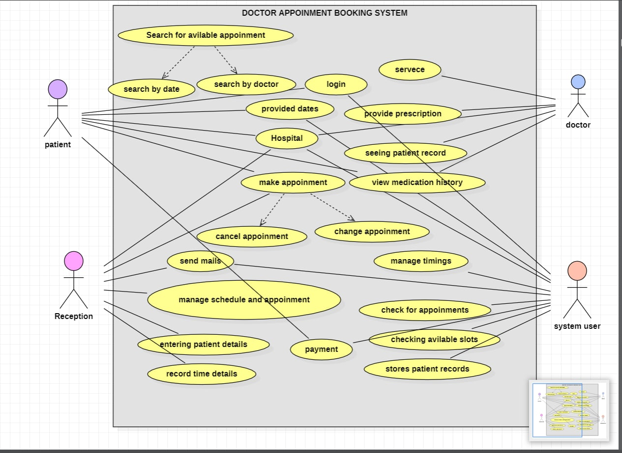
USE CASE Diagram for Doctor Appointment System

Slide 5
Proposed Algorithm Design Technique
A doctor appointment booking system, available on the internet, allows patients to book an appointment from the comfort of their homes, using their computer, laptop or mobile, and at any time. No matter where they are, they can contact doctors of their choice in any location.
Investing in patient communication technology can shorten the time it takes to get a patient scheduled and registered. Texting a patient to confirm an appointment with a reminder to update personal information, complete lab work, or make a co-payment cuts down on the amount of time your office staff needs to spend on these administrative tasks when the patient checks in for the appointment. For busy office staff, this can be a major time-saver.

Slide 6
Doctors Appointment System
Doctor management
Time slot
Appointment management
System user management
Login Management
Patient Management

Slide 7
Data Structures Needed
1.LIST
2.ARRAYS
3.MYSQL
4.HTML,CSS
5.Python Django framework
6. ………….

Slide 8
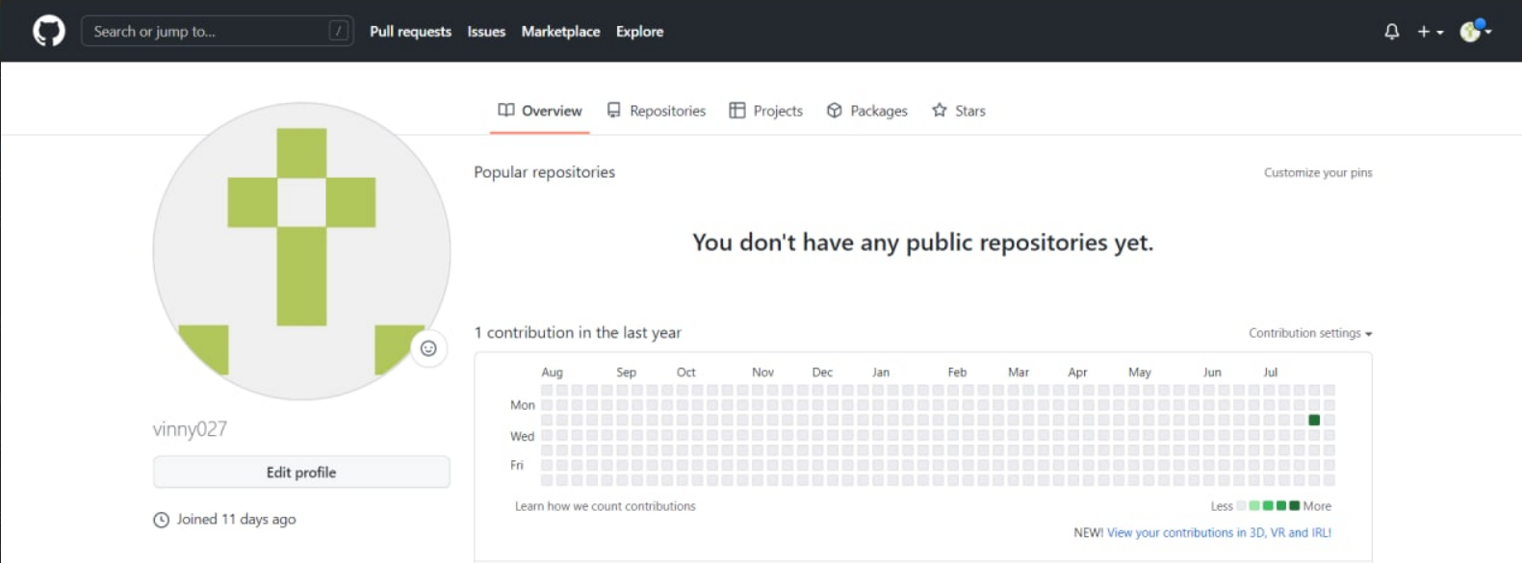
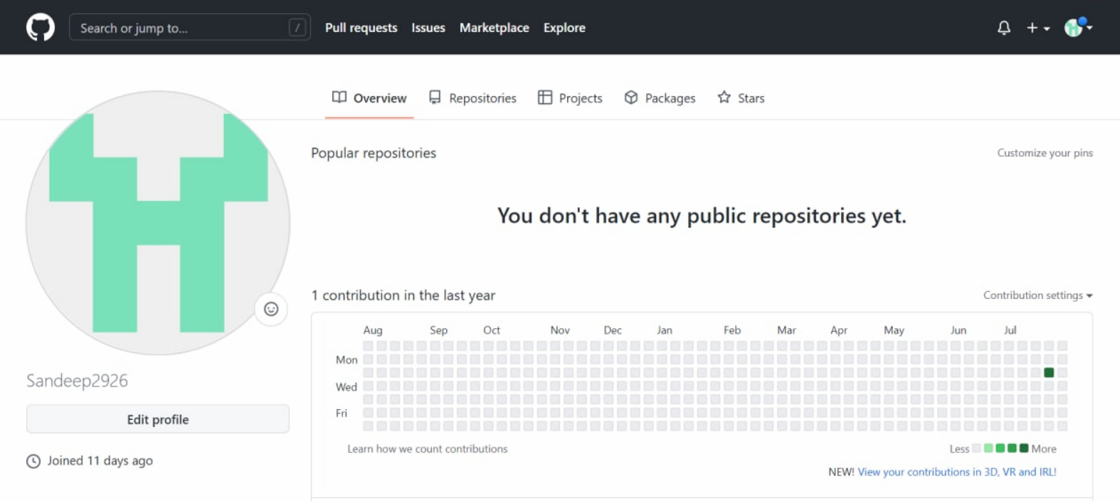
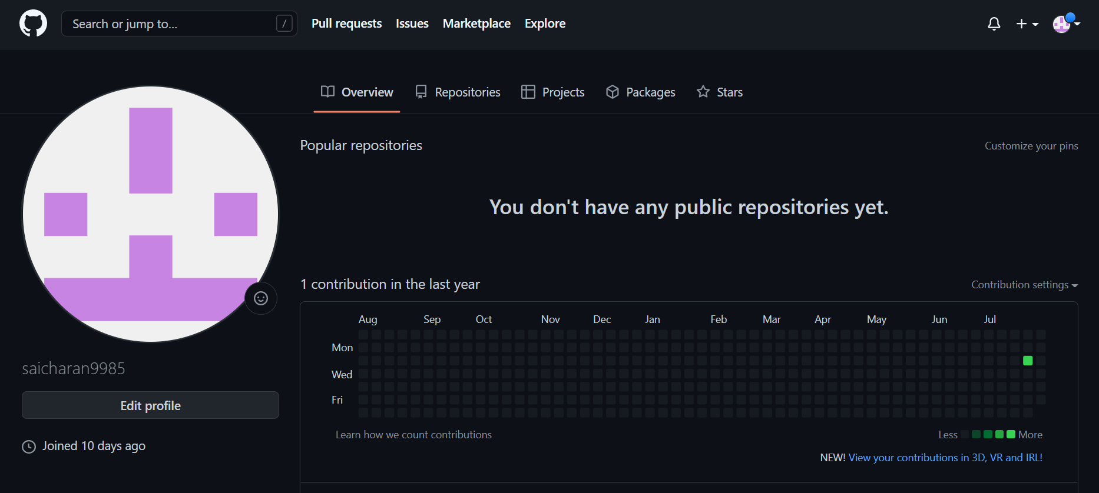
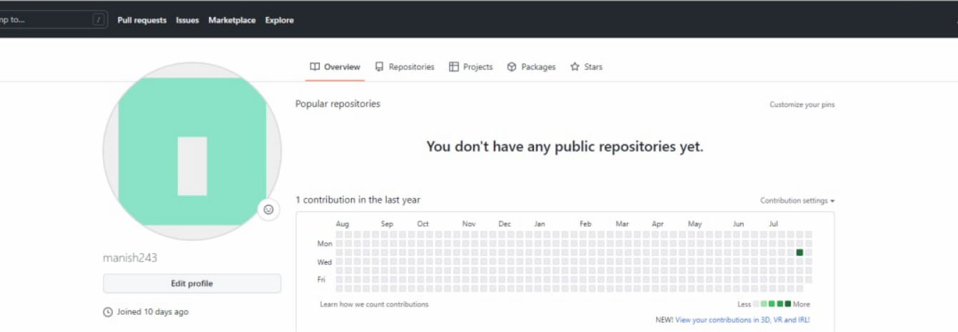
Github setup

Slide 9
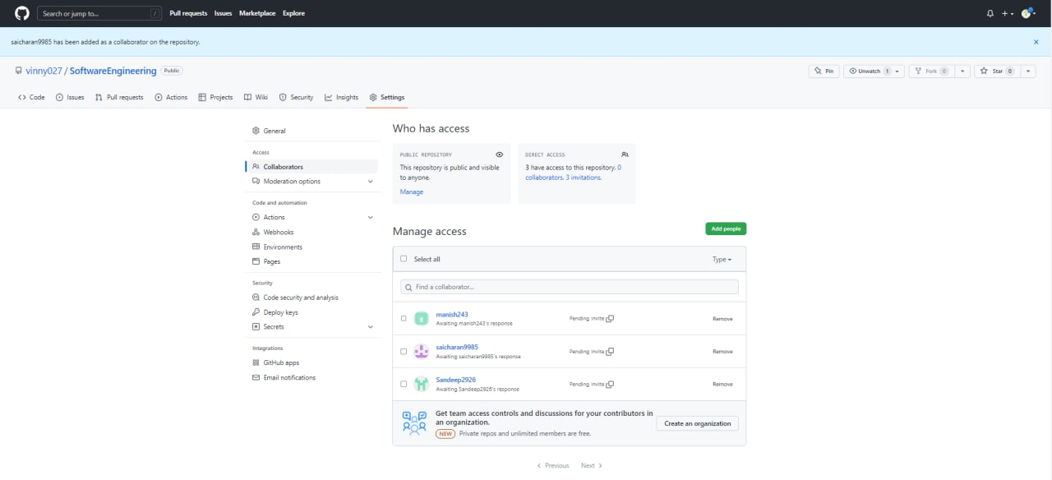
GitHub Setup

Slide 10
Division of work among the group members
A. Vinay Kumar(2110030350)- USE Case Diagram
T. Sandeep(2110030196)- USE Case Diagram
G. Sai Charan(2110030437)- Template
R. NagaManeeshwar(2110030344)- Research

